Slide 1
HTML HyperText Markup Language

Slide 2
What is HTML???
H
Hyper
Hyper signifies to move from one page to another with anchor tag.
T
Text
It means simple text.
M
Markup
You write the text with some mark-up like headings, bold, bullets, and so on.
L
Language
It is in simple English Language.

Slide 3
HTML Developed by scientist Tim Berners-Lee in 1990, HTML is the "hidden" code that helps us communicate with others on the World Wide Web (WWW).

Slide 4
History
1991 HTML
1994 HTML2
1996 CSS1 +JavaScript
1997 HTML 4
2009 HTML5=HTML+CSS+JS

Slide 5
Editors
An HTML file must have an .htm or .html file extension
HTML files can be created with text editors:
NotePad, NotePad++, PSPad, EditPlus
Or HTML editors(WYSIWYG Editors):
Microsoft FrontPage
Macromedia Dreamweaver
Netscape Composer
Expression Web

Slide 6
Fundamental tags:

Slide 7
First HTML Page: Header
HTML Header
<html>
<head>
<title>My First HTML Page</title>
</head>
<body>
<p>This is first HTML Page…</p>
</body>
</html>

Slide 8
First HTML Page: Tags
<html>
<head>
<title>My First HTML Page</title>
</head>
<body>
<p>This is first HTML Page…</p>
</body>
</html>
HTML body

Slide 9
Link
Links: allow users to click their way from page to page.
Syntax:<a href="url">link text</a>
Example:
<!DOCTYPE html>
<html>
<body>
<p><a href="html_images.asp">HTML Images</a> is a link to a page on this website.</p>
</body>
</html>

Slide 10
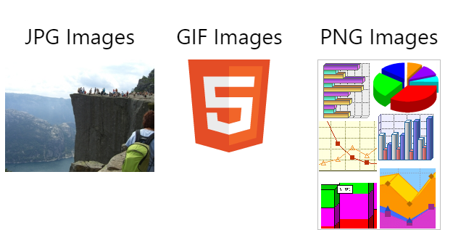
Output:

Slide 11
Image:
Images syntax:
<img src="photo.jpg">
Example
<!DOCTYPE html>
<html>
<body>
<h2>Spectacular Mountain</h2>
<img src="pic_mountain.jpg" alt="Mountain View" style="width:304px;height:228px;">
</body>
</html>

Slide 12
Output:

Slide 13
Attributes In HTML
Elements in HTML have attributes; these are additional values that configure the elements or adjust their behaviour in various ways to meet the criteria the users want.
For Example:
Action in <form>
Align in <img>, <table>, <head> and so on.

Slide 14
Tables
A table is defined using the <table> element, and contains a number of table cells ( <td>, for "table data" ) which are organized into table rows ( <tr>). The markup (HTML code) for a table is always based on rows, never columns. It Contains 4 sub Parts:
Table Row <tr></tr>
Table Header <th></th>
Table Data <td></td>
Caption <caption></caption>

Slide 15
Example:
<table>
<tr>
<th>Name</th>
<th>Favorite Color</th>
</tr>
<tr>
<td>Bob</td>
<td>Yellow</td>
</tr>
<tr>
<td>Michelle</td>
<td>Purple</td>
</tr>
</table>

Slide 16
Output:

Slide 17
List
Lists are the preferred way to display items one after the other, instead of just using <br> tags. Lists are easy to create, with a tag to start and end the list itself, and a tag to start an end each item in the list.
There are three types of lists:
1.Ordered
2. unordered
3. definition lists.

Slide 18
Html list tags:

Slide 19
Unordered list:
<!DOCTYPE html>
<html>
<body>
<h2>An Unordered HTML List</h2>
<ul>
<li>Coffee</li>
<li>Tea</li>
<li>Milk</li>
</ul>
</body>
</html>

Slide 20
Output:

Slide 21
Ordered list:
<html>
<body>
<h2>An Ordered HTML List</h2>
<ol>
<li>Coffee</li>
<li>Tea</li>
<li>Milk</li>
</ol>
</body>
</html>

Slide 22
Output:

Slide 23
Definition lists.
<!DOCTYPE html>
<html>
<body>
<dl>
<dt>Coffee</dt>
<dd>Black hot drink</dd>
<dt>Milk</dt>
<dd>White cold drink</dd>
</dl>
</body>
</html>

Slide 24
Output:

Slide 25
Form
Forms are used to collect data inputted by a user. They can be used as an interface for a web application, for example, or to send data across the web.
The basic tags used in the actual HTML of forms are <form>, <input>, <textarea>, <select> and <option>.

Slide 26
Textfield in form:
Text field :Text field are used when you want the user to type letter ,number etc. in a form.
Example:
<form>
First name:<input type=“text” name=“first name”/>
Last name:<input type=“text” name=“last name”/>
</form>

Slide 27
Output of Textfield:

Slide 28
Radio button:
Radio buttons:
<form>
<input type=“radio” name=“sex” value=“male”/>male<br/>
<input type=“radio” name=“sex” value=“female”/>female<br/>
</form>

Slide 29
Output

Slide 30
Checkboxes:
Checkbox:
<form>
Bike:<input type=“checkbox” name=“vehicle” value=“Bike”/><br/>
Car:<input type=“checkbox” name=“vehicle” value=“car”/><br/>
</form>

Slide 31
Output:

Slide 32
Action attribute and submit button:
When the user click on the ”submit” button the content of the form is sent to the server.
The form action attribute define the name of the file to send the content to.
It depends upon the php file.
Example:
<form
name=“input”=action=“html_form_submit.asp”method=“get”>
Username:<input type=“text” name=“user”/>
<input type=“submit” value=“submit”/>
</form>

Slide 33
Output:

Slide 34
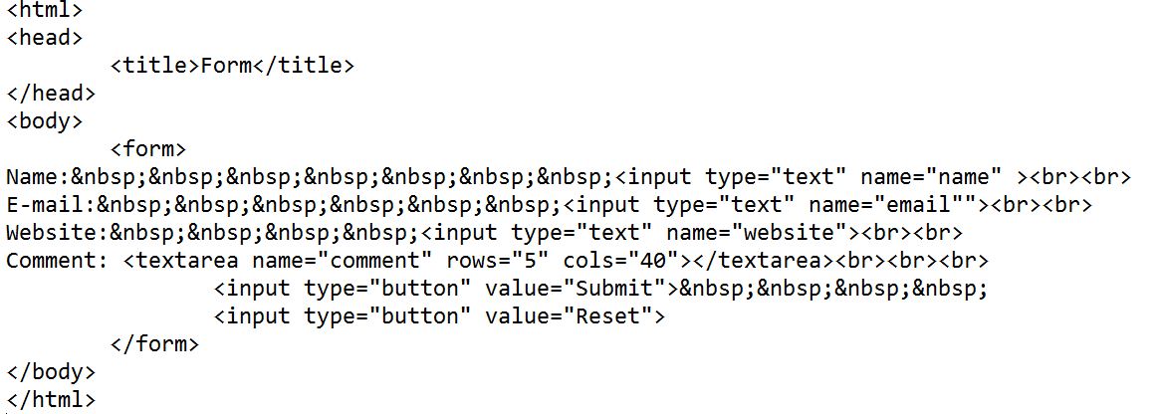
Example

Slide 35
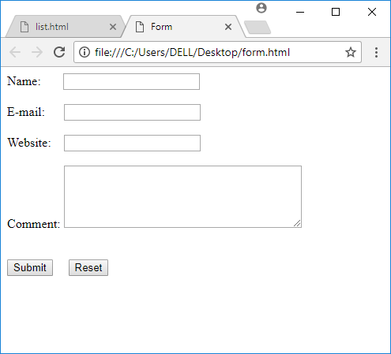
Output

